Slide 1

Ethical Approach
AI in Medicine: Ethics

Slide 2
Agenda
Overview.
Related Work.
The need to Extend related work.
Scope of work.
Contribution.
Results.
Future Work.

Slide 3
Agenda
Overview.
Related Work.
The need to Extend related work.
Scope of work.
Contribution.
Results.
Future Work.

Slide 4
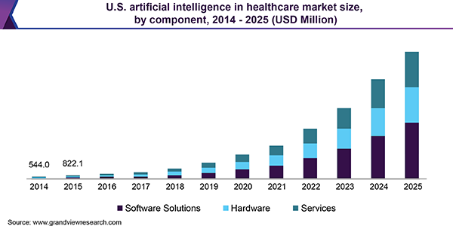
Graphs showing the growing prevalence of AI in medicine.

Slide 5
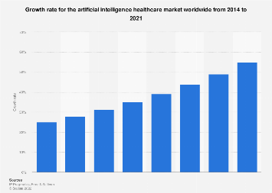

Slide 6

New Phenomena = Ambiguous Ethics
A lot of questions are asked, but no clear answers are given.

Slide 7
Agenda
Overview.
Related Work.
The need to Extend related work.
Scope of work.
Contribution.
Results.
Future Work.

Slide 8
Studied papers in the research
[1] Varmalov, O, Chuvikov, D, Adamova Larisa, Petrov, M, Zabolotskaya, I & Zhilina, T 2019, Logical, Philosophical and Ethical Aspects of AI in Medicine, International Journal of Machine Learning and Computing, Vol. 9, No. 6, pp. 868-873
[2] Kostic, E, Pavlovic, D, Zivkovic, M 2019 APPLICATIONS OF ARTIFICIAL INTELLIGENCE IN MEDICINE AND PHARMACY - ETHICAL ASPECTS, Acta Medica Medianae, pp. 128-139.
[3] Rubeis, G 2020, ‘The disruptive power of Artificial Intelligence. Ethical aspects of gerontechnology in elderly care’, Archives of Gerontology and Geriatrics.
[4] Guan, J 2019, ‘Artificial Intelligence in Healthcare and Medicine: Promises, Ethical Challenges and Governance, Chin Med Sci J, Vol. 34, No. 2 P. 76-83.

Slide 9
Agenda
Overview.
Related Work.
The need to Extend related work.
Scope of work.
Contribution.
Results.
Future Work.

Slide 10
The need to extend related work
Few details ,few information.

Slide 11
Agenda
Overview.
Related Work.
The need to Extend related work.
Scope of work.
Contribution.
Results.
Future Work.

Slide 12
Scope of work.
We chosed four of the most famous important questions in this aspect, we used the four papers to get answers to these papers.
Q1. Does a patient become just a bunch of numbers and statistics?
Q2. How would a machine emphasize patients, especially elderly people?
Q3. How could we permit a machine to make vital decisions about people’s lives?
Q4. Do we have equal opportunities of benefiting from this technology?

Slide 13
Agenda
Overview.
Related Work.
The need to Extend related work.
Scope of work.
Contribution.
Results.
Future Work.

Slide 14
APPLICATIONS OF ARTIFICIAL INTELLIGENCE IN MEDICINE AND PHARMACY - ETHICAL ASPECTS

Slide 15
Artificial neural networks(ANNs):
01
The most important application of AI in medicine.

Slide 16
Ethical Aspects
Privacy
Property
Accessibility
PAPA
Accuracy
Is it necessary to develop new technologies?

Slide 17
Philosophical and Ethical Aspects of AI in Medicine
Narrow AI
1
2
Logical AI
General AI
3

Slide 18
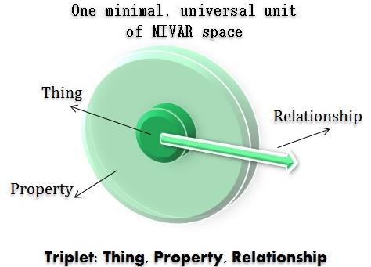
MIVAR ??

Slide 19
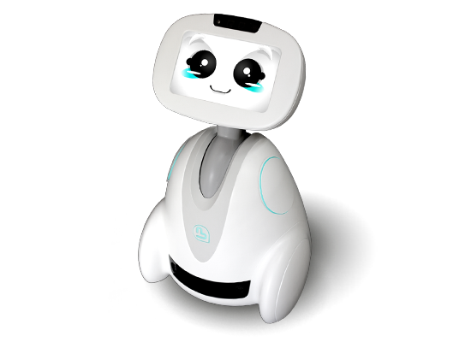
Can a machine show mercy ?
MIVAR way
Mirror neurons way

Slide 20
Social & Psychological aspects
Can we study ethics by psychological sides ?
HISTORY.

Slide 21
Artificial intelligence in healthcare and medicine: promises, ethical challenges, and governance

Slide 22
Paper summary :
1)Intro to AI in medicine.
2)Quick idea about the applications of AI , and it’s categories.
3)The paper highlights challenges that may help us to answer our question.
4)Does a patient become just a bunch of numbers and statistics?”.
5)Ethical rules in AI .

Slide 23
1) Intro to AI in medicine :
1) the paper gives us some information on the chip “truthnorth”, which can give machines and computers some of the human brain-like abilities.
2) Governments have already paid attention to making plans and strategies like “NG-PI”.

Slide 24
2) Quick idea about the applications of AI , and it’s categories
-AI divided into three main branches virtual, physical, and combination between virtual reality and robots.
-Physical branch like surgical robots, robot moxi.
-Virtual branch like virtual AI via machine learning .

Slide 25
3) The paper highlights challenges that may help us to answer our question
- It confirms that it is important to find the balance among three relationships:
1) Science - medical indication
2) Human society - safety and priority of life
3) Individual - patient desire

Slide 26
4)Does a patient become just a bunch of numbers and statistics?”
In the paper ,the answer is yes but we will know why at the end.

Slide 27
5)Ethical rules in ai
-The first rule is that clinical staff must be careful with patient’s life as technical errors associated with such technologies may cause problems and don’t take risks.
-The second rule is giving priority to the individual’s interests.

Slide 28

The disruptive power of Artificial Intelligence. Ethical aspects of gerontechnology in elderly care

Slide 29
Ethical model
01
4p-medicine
02
4d-risks
AI can be elaborated in order to actualize its 4p-potential and diminish its risks.

Slide 30

01
4p-medicine
By combining large data sets from electronic health records, AI systems could fulfill the promise of the so-called 4p-medicine.

Slide 31
Big Data-applications could be used for
predictive analysis of disease progression and health risks.
personalizing care management.
Prediction
personalization
prevention
participation
preventing health risks based on behavioral analytics.
Enabling participatory patient engagement in collecting and sharing health data.

Slide 32
02
4d-risks
The four “ds” stand for a depersonalized, discriminatory, dehumanized, and disciplining elderly care.

Slide 33
The risks of AI in elderly care: the 4ds
The mere fact that persons have to interact with robots instead of human caregivers may be experienced as a loss of humanity.
the use of data sets from large cohort studies may lead to an opposite outcome.
Depersonalization
Dehumanization
Discrimination
Disciplination
The application of AI implies the use of social information and may thus lead to the discrepancy between virtual social identity and actual social identity.
the downside of these technologies is the constant surveillance. This means an intrusion into privacy since almost every aspect of daily life is monitored.

Slide 34
Agenda
Overview.
Related Work.
The need to Extend related work.
Scope of work.
Contribution.
Results.
Future Work.

Slide 35
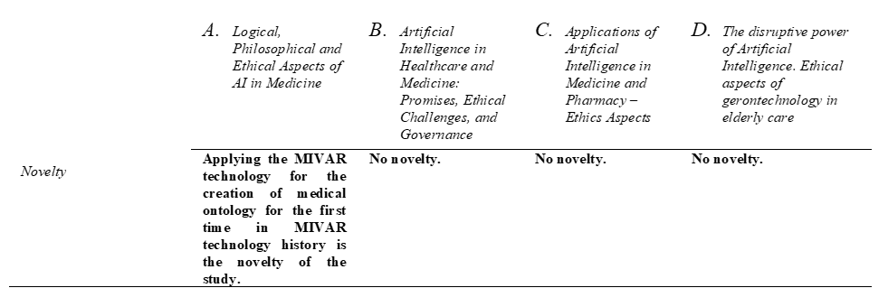
Conclusion
Full comparison between the four papers Novelty

Slide 36
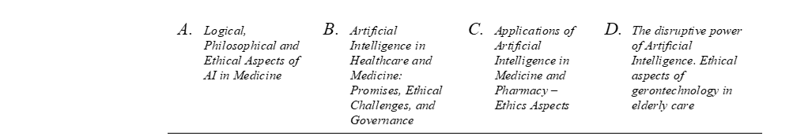
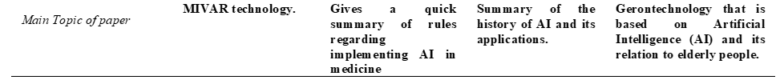
Main Topic of paper

Slide 37
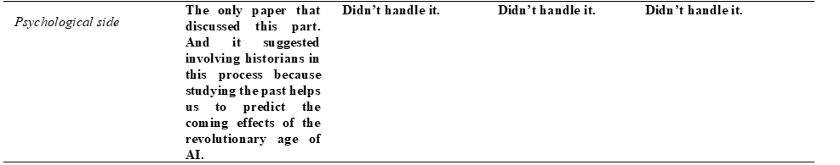
Psychological side

Slide 38
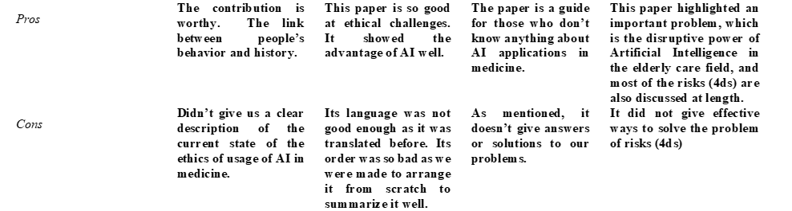
Pros and Cons

Slide 39
The most important questions about AI in medicine
We used four pieces of research that handled ethics of AI in medicine.
We tried to find answers to four of the most important questions that show up when we speak about implementing AI in medicine.

Slide 40
1st Question
People usually ask whether patients become a bunch of numbers without paying attention to their feelings.
Unfortunately we found it true.

Slide 41
2nd Question
Can a machine emphasize with patients?
Yes, by using many technologies such as MIVAR technology and Mirror neurons technology.

Slide 42
3rd Question
How could we permit a machine to make vital decisions about people’s lives?
We can’t do this, because the algorithms of AI machines in the world are not accurate, at least for now.

Slide 43
4th Question
Do we have Equal opportunities of benefiting from this technology?
Unfortunately no, but again at least for now.

Slide 44
Agenda
Overview.
Related Work.
The need to Extend related work.
Scope of work.
Contribution.
Results.
Future Work.

Slide 45
Future Work
We want to read more about AI applications and its algorithms and we will try to develop new applications.

Slide 46
References
[1] Jutzi, T, Krieghoff-Hennig, E, Hollanz-Letz,T, Utikal, J, Hauschild, A, Schadendorf, D, Sondermann, W, Fröhling, S, Hekler, A, Schmitt, M, Maron, Roman & Brinker, T 2020, Artificial Intelligence in Skin Cancer Diagnostics: The Patients' Perspective, Frontiers in Medicine, vol.7, article 233.
[2] Varmalov, O, Chuvikov, D, Adamova Larisa, Petrov, M, Zabolotskaya, I & Zhilina, T 2019, Logical, Philosophical and Ethical Aspects of AI in Medicine, International Journal of Machine Learning and Computing, Vol. 9, No. 6, pp. 868-873.
[3] Kostic, E, Pavlovic, D, Zivkovic, M 2019 APPLICATIONS OF ARTIFICIAL INTELLIGENCE IN MEDICINE AND PHARMACY - ETHICAL ASPECTS, Acta Medica Medianae, pp. 128-139.
[4] Rubeis, G 2020, ‘The disruptive power of Artificial Intelligence. Ethical aspects of gerontechnology in elderly care’, Archives of Gerontology and Geriatrics.
[5] Guan, J 2019, ‘Artificial Intelligence in Healthcare and Medicine: Promises, Ethical Challenges and Governanc’, Chin Med Sci J, Vol. 34, No. 2 P. 76-83.
[6] O. O. Varlamov, M. O. Chibirova, A. M. Khadiev, P. D. Antonov, G. S. Sergushin, I. A. Shoshev, and K. V. Nazarov, Manual of the MIVAR Expert Systems Creation, Moscow, Russia: White Wind, 2016, p. 180.

Slide 47

QUESTIONS ?

Slide 48
Bye Thanks for listening

